Slide 1
The Romantic Period
1800-1832

Slide 2
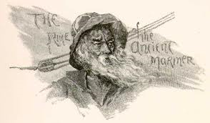
Two of the most important works in English literature:
“The Rime of the Ancient Mariner” by Samuel Taylor Coleridge
“Lines Composed a Few Miles Above Tintern Abbey” by William Wordsworth

Slide 3
The Romantic Period basically began with the French Revolution in 1789 and ended with the Parliamentary reforms of 1832 which laid the political foundation for modern Britain.

Slide 4
The Romantic Poets
William Blake
William Wordsworth
Samuel Taylor Coleridge
Percy Bysshe Shelley
John Keats
Lord Byron

Slide 5
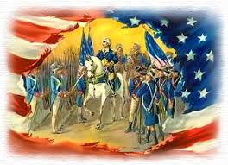
The American Revolution and England
The American Revolution hurt England economically. It also resulted in a loss of prestige and confidence.

Slide 6
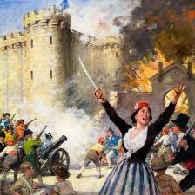
The French Revolution began with the storming of Bastille prison on July 14, 1789. English conservatives were afraid their citizens would revolt as well.

Slide 7
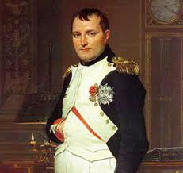
England vs. France 1793
France was led by Napoleon Bonaparte, an officer in the army that declared himself emperor in 1804. He was finally defeated in Waterloo, Belgium, in 1815.

Slide 8
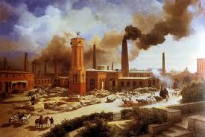
The Industrial Revolution
England was the first nation in the world to feel the effects of the Industrial Revolution. Eventually, the Industrial Revolution led to terrible living conditions in cities, individual farmers taking over communal land, and the poor migrating to cities and being forced to beg for their living.

Slide 9
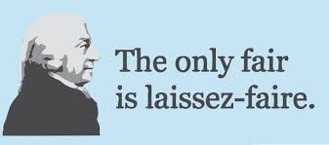
Laissez Faire “Let people do as they please”
Under this policy, the rich grew rich and poor grew poorer.

Slide 10
The Romantics
Sought meaning through imagination, not reason
The romance genre allowed writers to explore new, more psychological and mysterious aspects of human experience.
“Romantic”:
A child’s sense of wonder – youth and innocence
Social idealism – people question tradition and authority in order to create a better society
Adaptation to change – acceptance of change

Slide 11
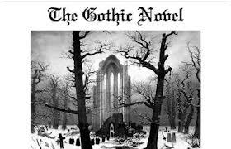
The Lure of the Gothic
The first Gothic novel was written by Horace Walpole. His intention was to scare people.

Slide 12
Romantic Poets
“Poetry is the spontaneous overflow of powerful feelings.” – William Wordsworth
Romantic poets believed there was a permanent and interactive bond between the human mind and nature.
“Mind Poets” sought a deeper understanding of the bond between human beings and the world of the senses.
The Romantics believed the imagination was superior to human reasoning. They also thought that imagination moved the mind to imitate the Maker of creation. For this reason, they believed that the poet was someone human beings and society could not do without.

Slide 13
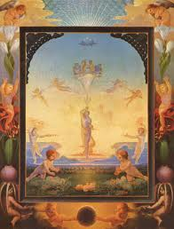
Major themes of the Romantic Period:
The natural
The fantastic
Truth
Beauty

Slide 14
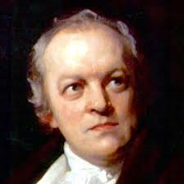
William Blake
Considered insane by contemporaries
Combined literary and visual art in poems
Created “illuminated printing” method
Criticized the dehumanization of child laborers
Denounced scientific theories of his time

Slide 15
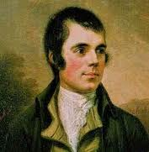
Robert Burns
Scottish
Songwriter, poet, farmer
Scots deprived of civil liberties: no firearms, no native dress, no bagpipes
“Protector” of Scottish language and folklore
Poems show respect for animals, nature, love, and simple pleasures
Wrote in a lowland Scots dialect
Sight (eye) Rhyme – occurs when the appearance of the rhyming units match, but the sounds do not; for example, “love” and “prove” look like they should rhyme, but do not

Slide 16
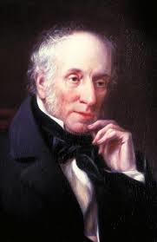
William Wordsworth
Insisted that poetry should express deep feelings about everyday experiences
Criticized “gaudiness and inane phraseology” of poetry that was in fashion
Enjambment – the continuation of a sentence in a poem from one line to the next

Slide 17
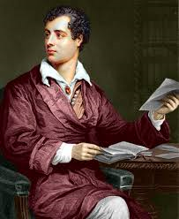
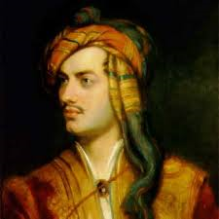
Lord Byron; George Gordon
“Mad, bad, and dangerous to know”
Aristocrat, poet, member of Parliament
Influenced art, fashion, and literature
National hero in Greece
Died at 36 from fever

Slide 18
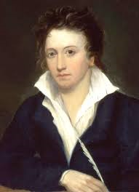
Percy Bysshe Shelley
“Mad Shelley”
Wrote gothic poems, melodramatic romances, and political literature
Moved to Ireland shortly after marrying, joined the movement for government reform, moved back to London, in debt, runs away with another woman, marries her, first wife drowns, moves to Italy with a new wife, loses two kids, new wife has a nervous breakdown, he drowns before his 30th birthday

Slide 19
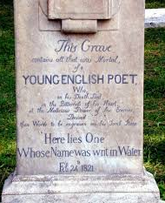
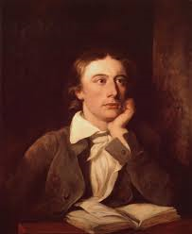
John Keats
Abandoned medicine for poetry at 21
Died of tuberculosis at 26
This Grave contains all that was mortal, of a YOUNG ENGLISH POET, who on his Death Bed, in the Bitterness of his heart, at the Malicious Power of his enemies, desired these words to be Engraven on his Tomb Stone
“Here lies one whose name was writ in water.”

Slide 20
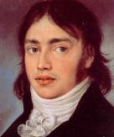
Samuel Taylor Coleridge
Became an opium addict as a child after nearly freezing to death
Attempted to set up an ideal community in Pennsylvania
Friends with Wordsworth
Greatest literary critic of his age
Prose essays and poems on religious subjects
Philosopher, journalist, and literary theorist

Slide 21
Vocabulary Words to Know
Aspire
Immortal
Sinews
Sulk
Symmetry
Discretion
Dominion
Impudence
Inconstantly
Presumption
Vintage
Impulse
Retort
Avarice
Reverence
Incitement
Sordid
Stagnant
Roused

